Slide 1
Welcome
12th Annual LON-CAPA Conference and Workshop
Dalhousie University
Gerd Kortemeyer
Michigan State University
May 14th, 2010

Slide 2
Year in Review
May 2009-May 2010

Slide 3
New High School Domains
San Mateo Union High School, CA
West Noble High School, IN
Ann Arbor Public Schools, MI
East Anchorage High School, AK
Lakenheath High School, Suffolk
Township High School District 211, IL
Boulder Valley School District, CO
Mountain View – Los Altos, CA
Mamaroneck High School, NY
Divine Child High School, MI
American International School Lagos, Nigeria

Slide 4
New University Domains
Universidade Federal da Bahia, Brazil
Queen’s University, Kingston, Ontario
National Cheng Kung University, Taiwan
Massachusetts Institute of Technology
Denison University, Ohio
Valparaiso University, Indiana
Lake Superior State University, Michigan

Slide 5
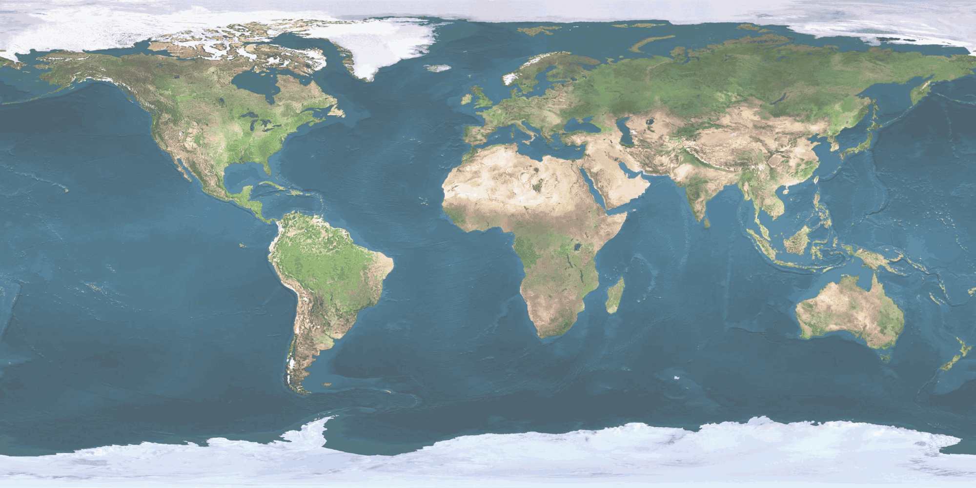
Domains
High Schools, Colleges, and Universities
Great Britain: 1
Germany: 3
Canada: 7
Turkey: 1
South Korea: 1
USA: 108
Switzerland: 1
Israel: 2
Taiwan: 1
Nigeria: 1
Brazil: 2
South Africa: 1
… plus grant projects and publishing companies.

Slide 6
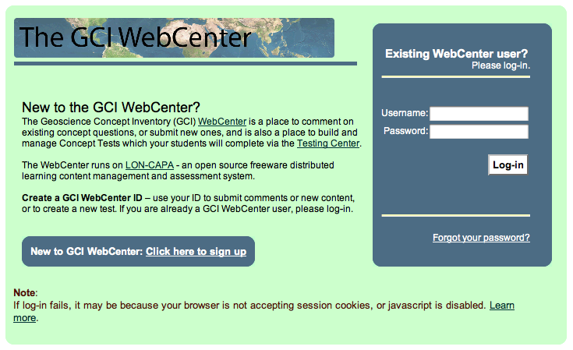
NSF Grant Project
Platform to develop and host concept inventories online

Slide 7
Scholarship involving LON-CAPA
Six peer-reviewed publications
Three conference proceedings
One book chapter
Three invited workshops
Six contributed conference talks

Slide 8
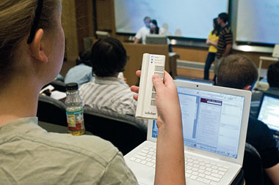
LON-CAPA in Germany and Brazil
Transferability of results

Slide 9
LON-CAPA at CeBIT
World’s largest computer fair
Hannover, Germany
Exhibit sponsored by the German state of Lower Saxony and Ostfalia University of Applied Science

Slide 10
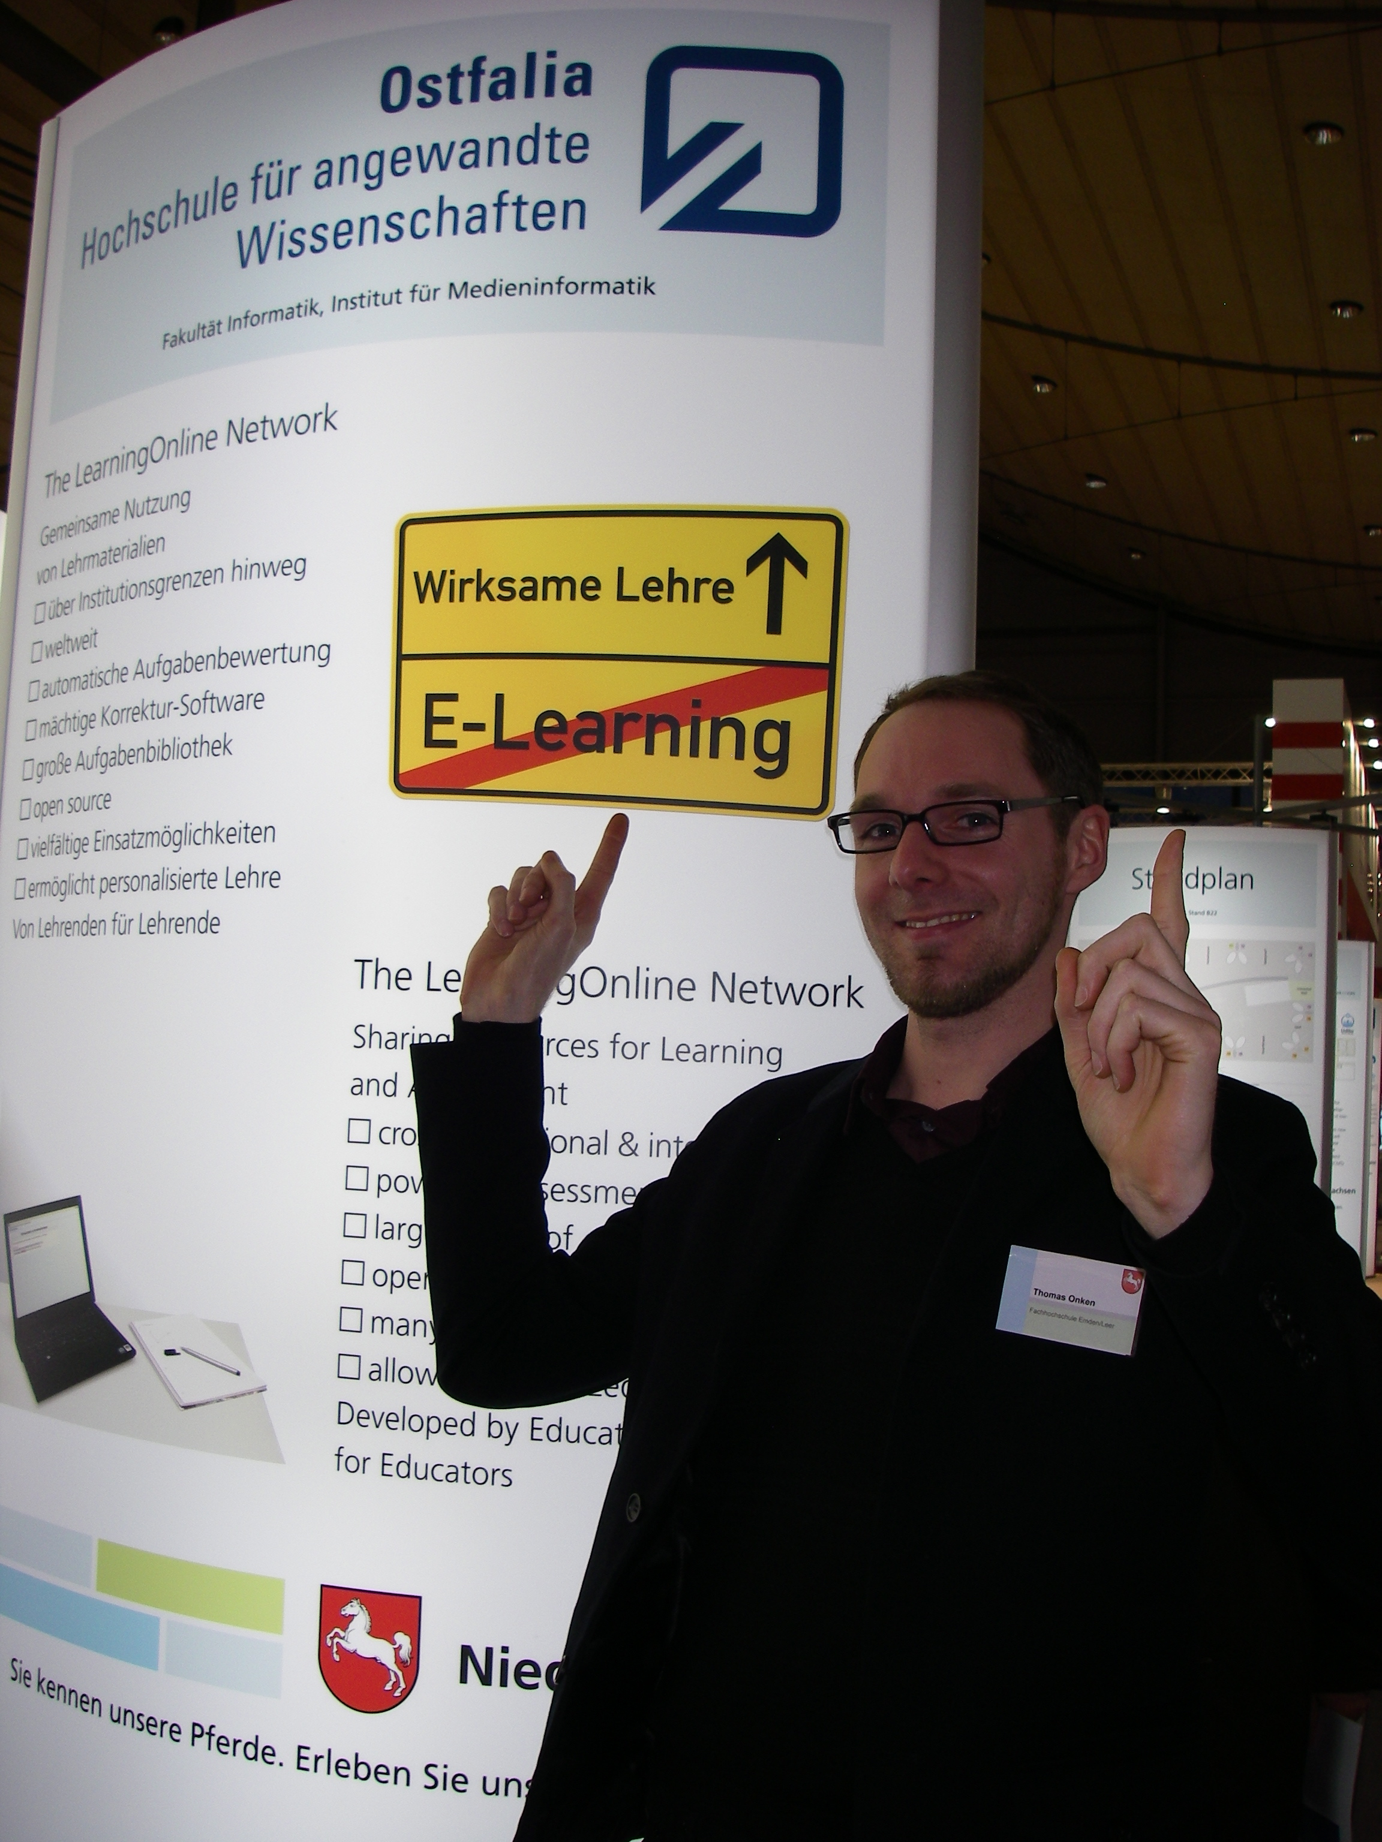
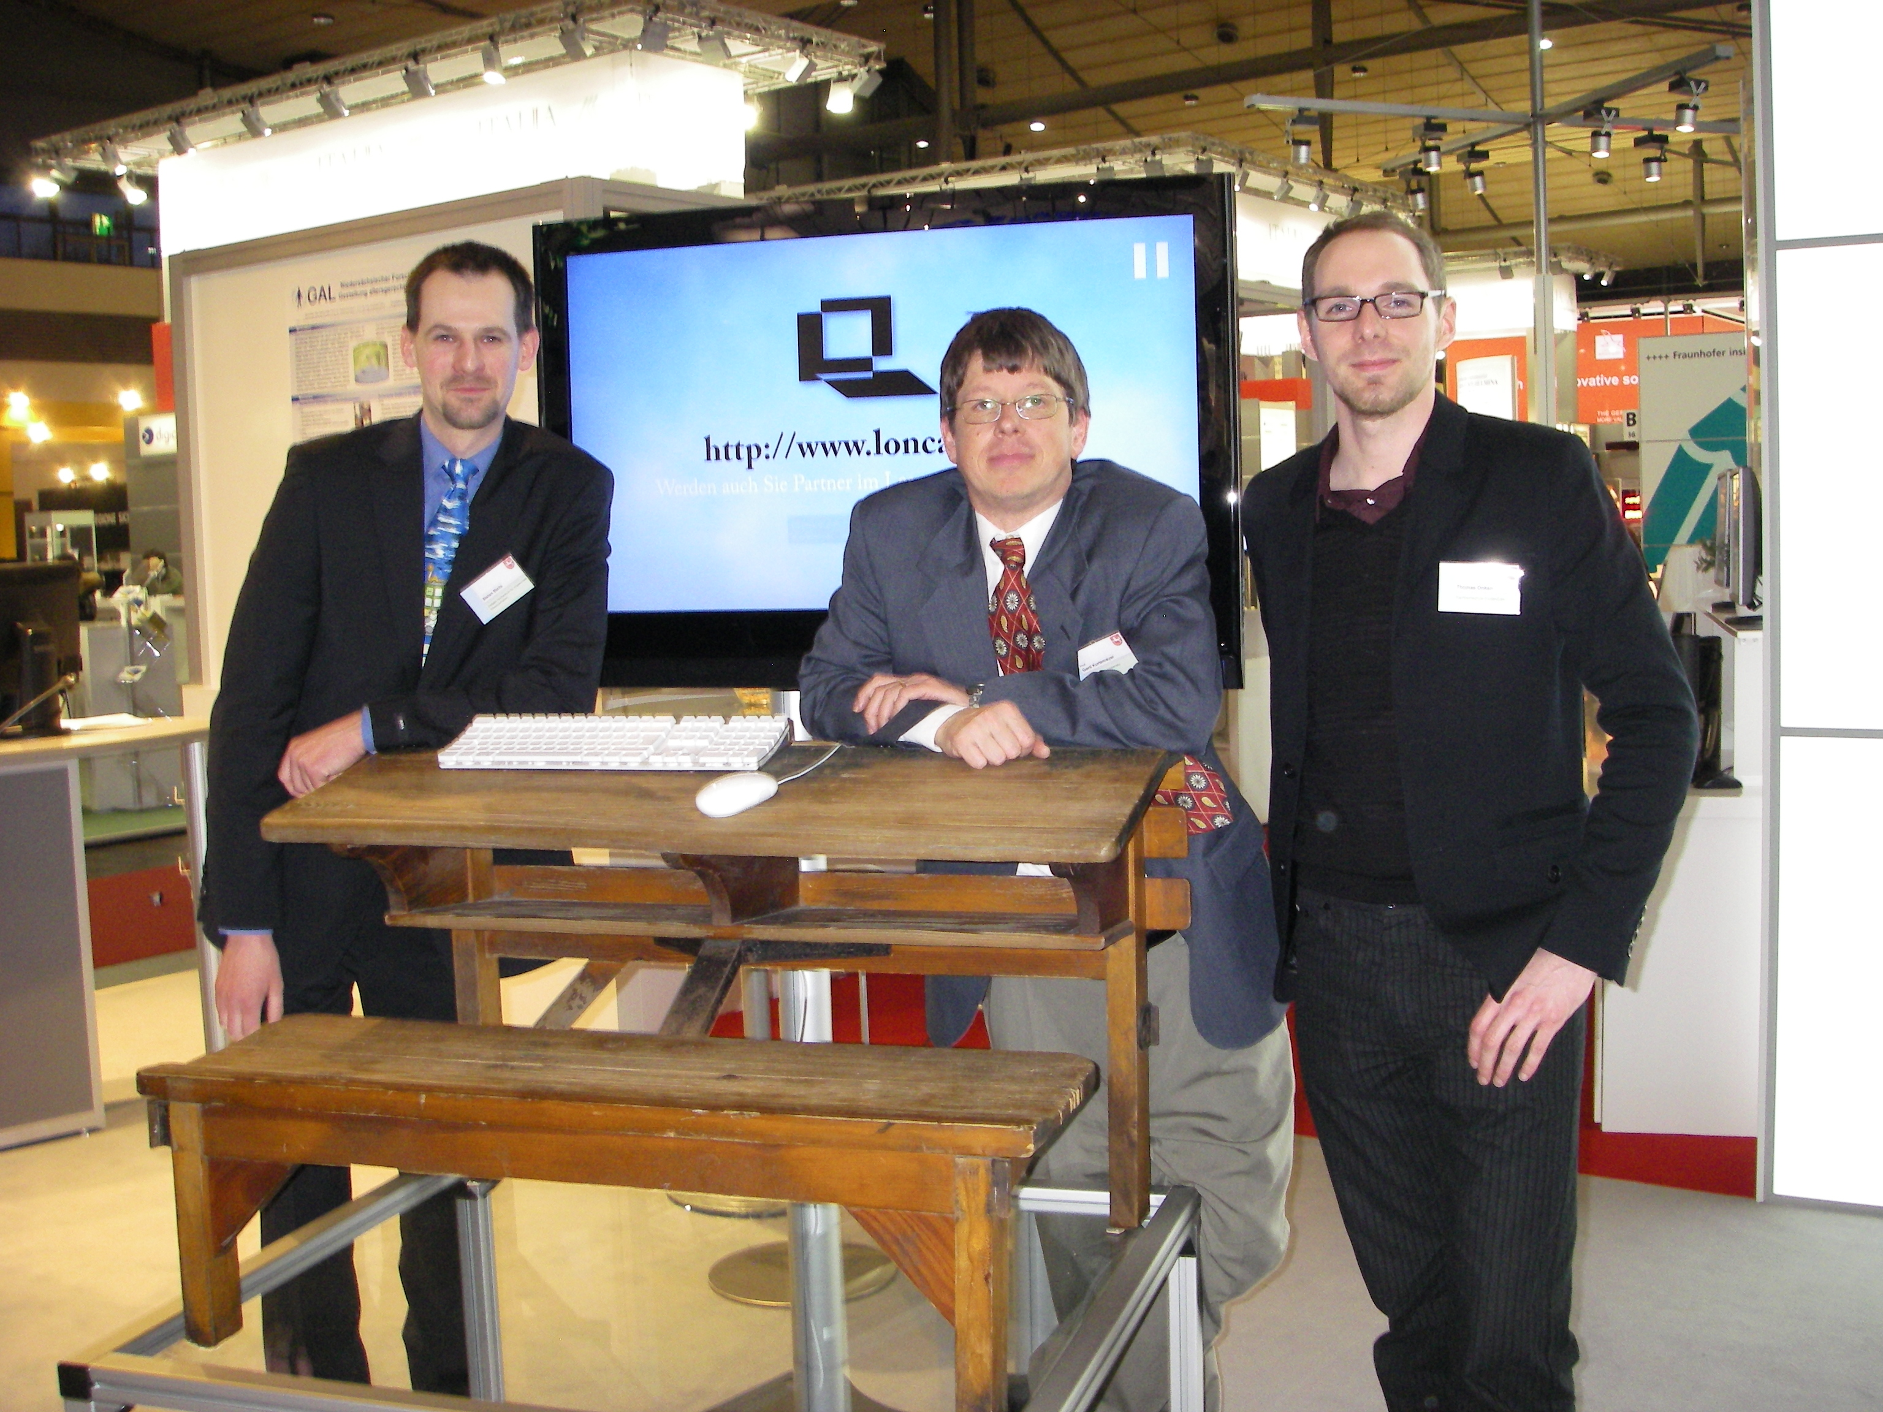
LON-CAPA at CeBIT

Slide 11
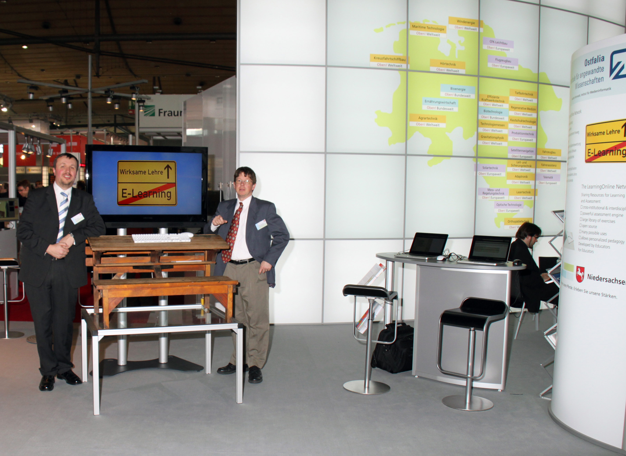
LON-CAPA at CeBIT

Slide 12
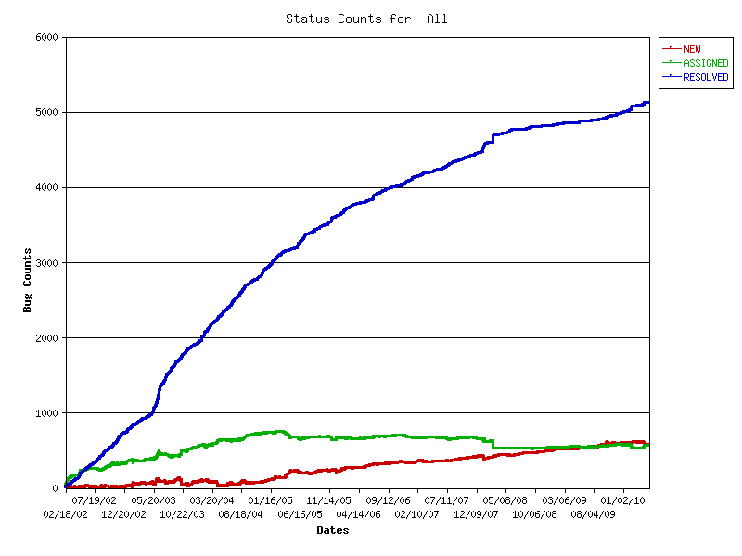
Bugzilla
Resolved almost 300 bugs and enhancement requests

Slide 13

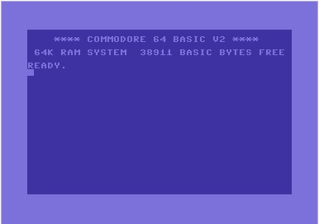
New Functionality
Communities
Course/Community Request Interface
Incorporation of R statistics system
Support for more operating system distributions
More on that tomorrow …

Slide 14

Redesign Project
Completed Project class on LON-CAPA Redesign at Ostfalia University of Applied Science
You’ll see here at the conference

Slide 15
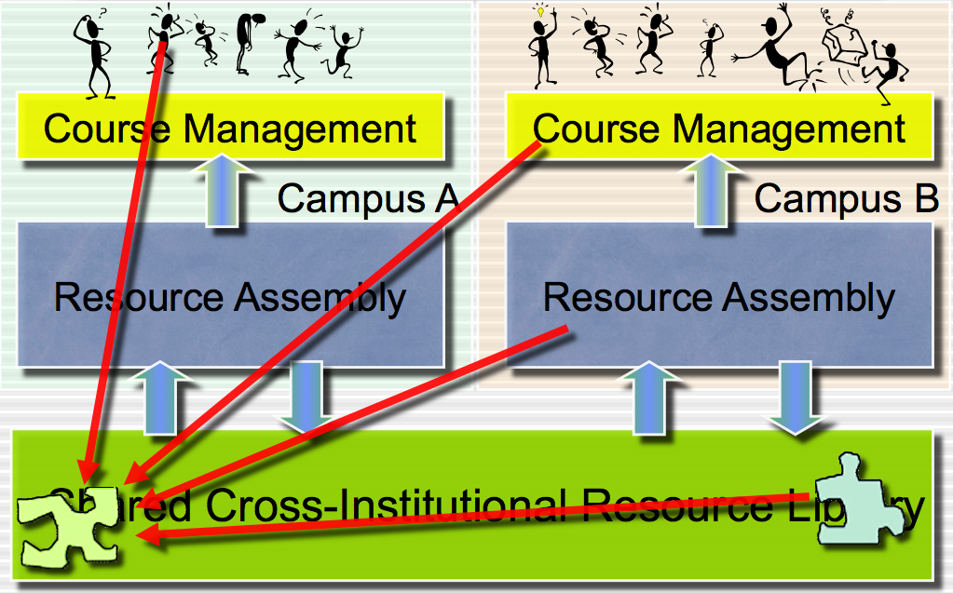
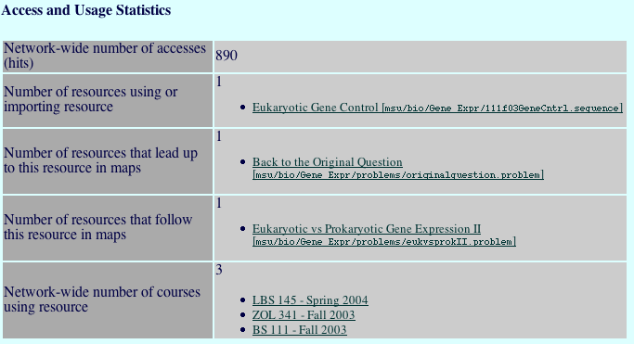
New Search Project
Thesis project: improving search
Make better use of dynamics metadata

Slide 16
Obituaries
Losses in 2010

Slide 17
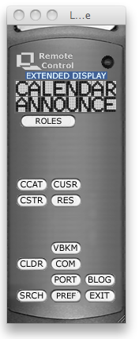

Remote Control 2000-2010
We loved you dearly, but you were just sort of in the way.
Rest in peace.

Slide 18
Outlook

Slide 19
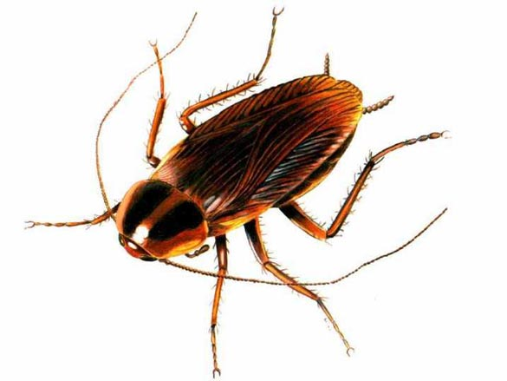
These are difficult times …
... central support for Information Technology is not what it used to be
We have been around for 17 years:
  Growing user community
  Growing resource pool
Moving beyond that:
  Spin-Off business
  Collaborations
  Grant project

Slide 20
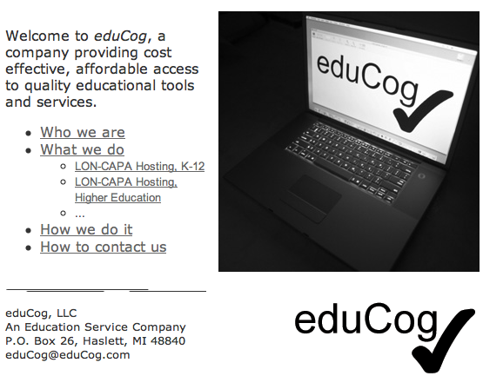
eduCog Spin-Off
Founded as part of NSF grant project sustainability plan
  Hosting for high schools
  Coding for textbook publishers

Slide 21
eduCog Spin-Off
Constant growth
Ready for next step

Slide 22
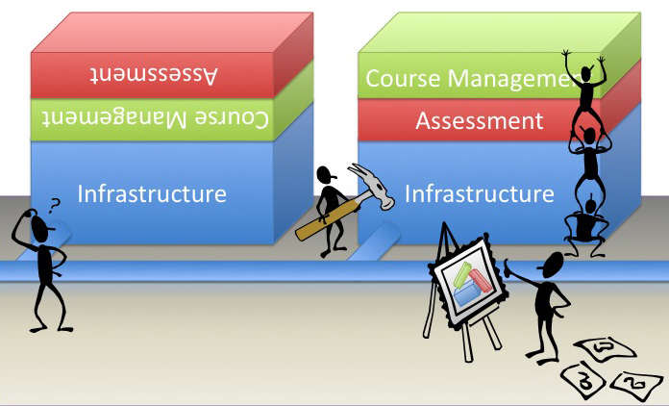
LON-CAPA 3.0
The old “3.0” turned into 2.10, because: 3.0 is going to be a bigger change
Talk on that tomorrow

Slide 23
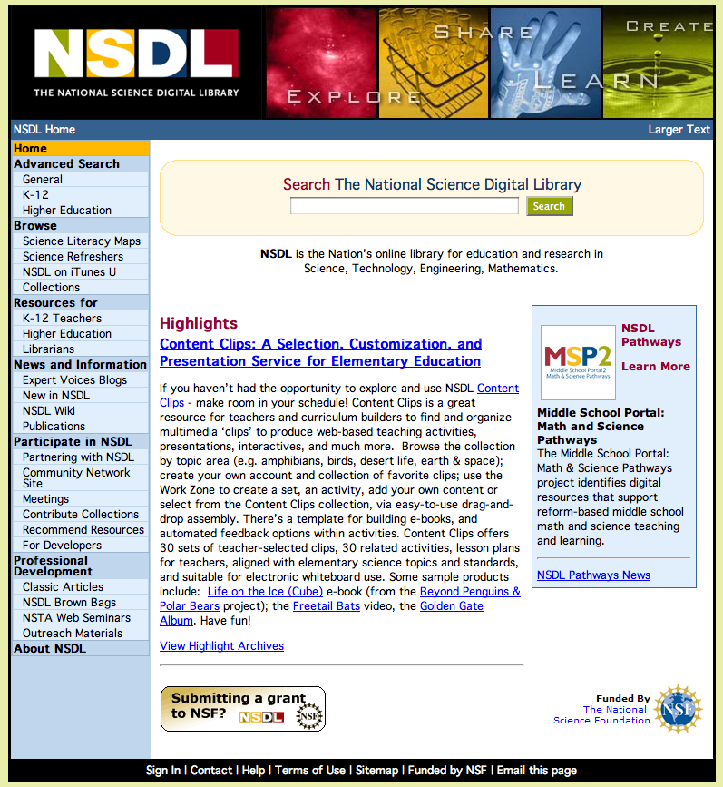
Grant: back to NSDL
Intellectual property rights management
Course delivery platform for NSDL content

Slide 24
Thanks!
Thanks to the organizers and hosts here at Dalhousie!
  Sheila Fougere
  Phil O’Hara
  Brian Lesser
  Derek, Andrew, Ryan,
  Rebecca, Nellie, …

